Slide 1

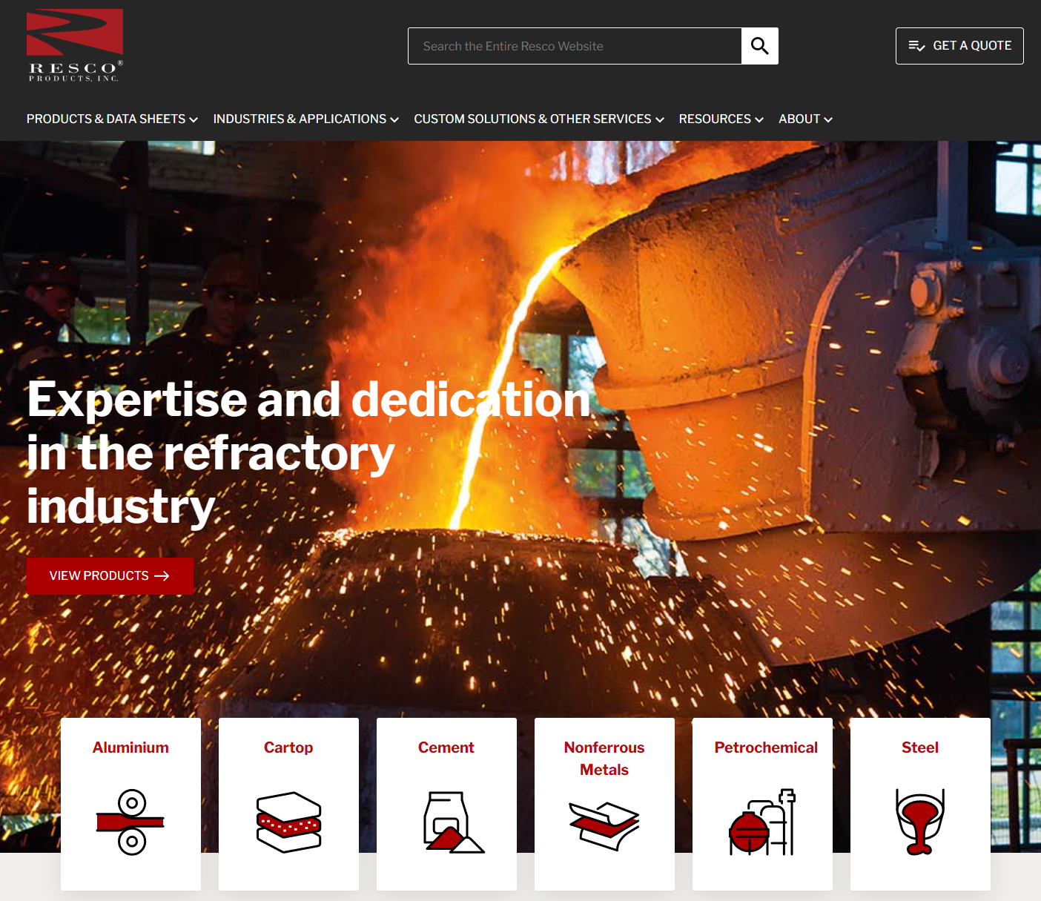
Resco Products Website
Business Need
Resco Products needed a modern, easy-to-manage website to better showcase their industrial product catalog and support their marketing efforts. Their previous site was difficult to update, lacked a strong mobile experience, and made it hard for customers to find product information and technical documentation.
What We Did
Redesigned the full user experience with a modern, mobile-responsive interface aligned to Resco’s branding
Implemented a new Sitefinity CMS environment to give the marketing team full control over content, products, and documents
Reorganized product categories and technical resources into a clean, intuitive information architecture
Migrated legacy content into Sitefinity and provided team training and documentation for ongoing management.
Results
Customers can now locate products, datasheets, and resources significantly faster, improving engagement and usability
Sitefinity enables Resco’s marketing team to publish updates and launch new pages without developer support
Mobile traffic performance improved through a fully responsive design
Overall site experience became more polished and professional, increasing credibility with prospects and customers.

